Slide 1
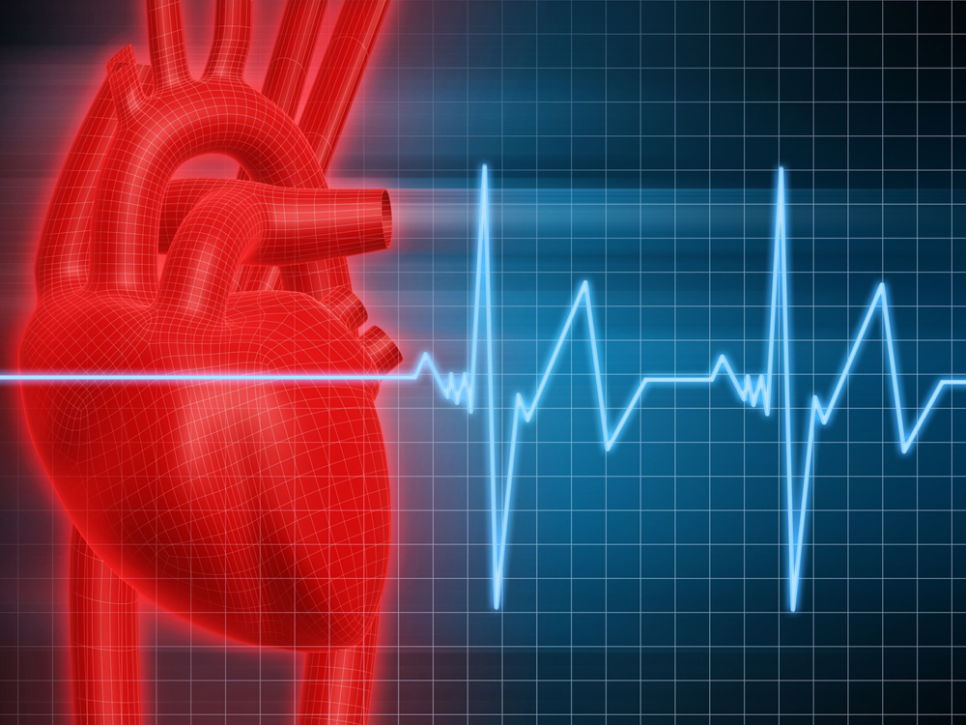
PTA/OTA 106
Unit 2 Lecture 2

Slide 2
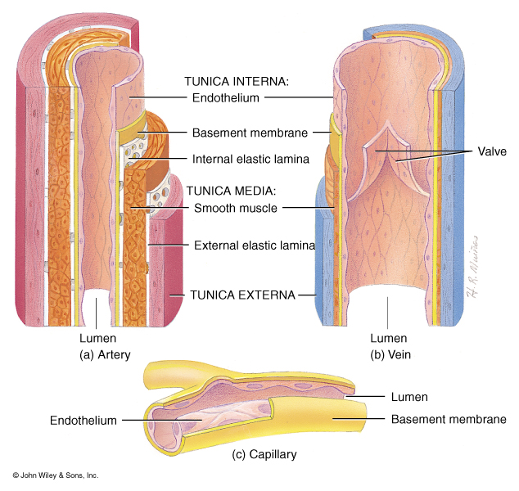
Comparative Structure of Artery and Vein Vessel Walls
Arteries:
1. Tunica Interna
a. Endothelium
b. Basement membrane
c. Internal elastic lamina
2. Tuncia Media
a. Smooth muscle
b. External elastic lamina
3. Tuncia Externa
a. Connective tissue

Slide 3
Comparative Structure of Artery and Vein Vessel Walls
Veins:
1. Tuncia Interna
a. Endothelium
b. Basement membrane
2. Tuncia Media
a. Smooth Muscle
3. Tuncia Externa
a. Connective Tissue
Capillary:
a. Endothelium
b. Basement membrane

Slide 4
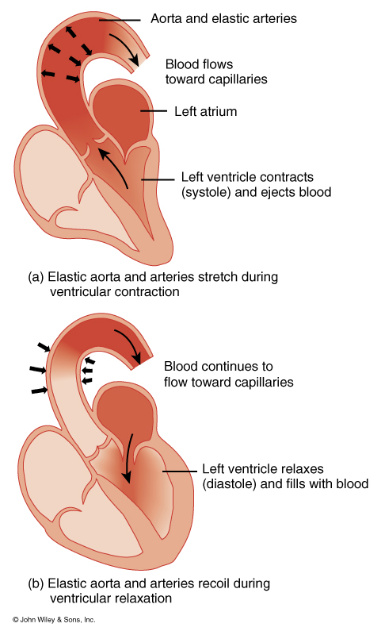
Classification of Arteries
Elastic Arteries
(Conducting arteries)
Aorta, Brachiocephalic, Commom Carotid, Subclavian, Vertebral, Pulmonary, Common Iliac
Muscular Arteries
(Distributing Arteries)
Brachial artery, radial artery, Popiteal, Common Hepatic

Slide 5
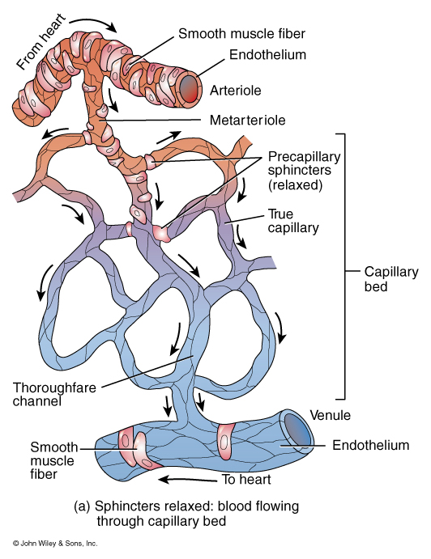
Circulation Through a capillary bed
Arterioles: deliver blood to capillaries
Metarterioles: emerges from arterioles and supplies a group of capillaries
Thoroughfare Channel: arise from metarterioles and contain no smooth muscle. Thoroughfares allow blood to bypass the capillary

Slide 6
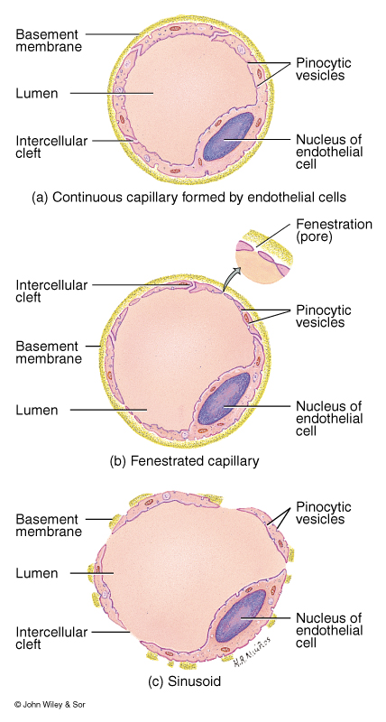
Different types of Capillaries
Continuous Capillaries
Plasma membranes of endothelial cells forms a continuous tube only interrupted by intercellular clefts (gaps between cells) (lungs and muscle)
Fenestrated Capillaries
Plasma membrane of endothelial cells contain pores or fenestrations
(Kidney and Villi of small intestines

Slide 7
Different types of Capillaries
Sinusoids:
Wider and more winding than other capillaries, with incomplete basement membranes and large fenestrations
(red bone narrow and liver)

Slide 8
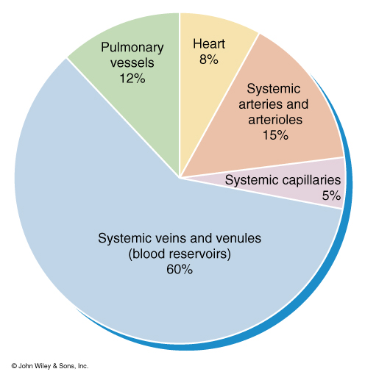
Blood distribution in the Cardiovascular System

Slide 9
Mechanisms of Capillary Exchange
Simple Diffusion:
(CO2, O2, glucose, amino acids, and hormones)
Transcytosis:
Substances enter lumen side of endothelial cells via endocytosis and exit the other side via exocytosis
Bulk Flow:
Substances dissolved in fluid are moved toward in the same direction as the fluid

Slide 10
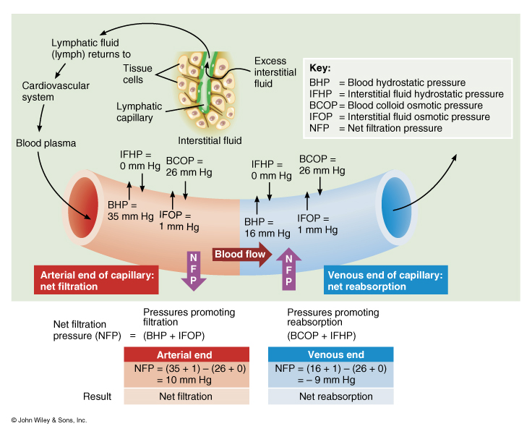
Forces involved in Capillary Exchange

Slide 11
Factors that Affect Capillary Exchange
Edema = increased Interstitial Fluid
1. Increased BHP
a. increased CO
b. increased blood volume
2. Increased Permeability of Capillaries
a. Increased IFOP
b. Bacteria
c. Tissue damage

Slide 12
Factors that Affect Capillary Exchange
Edema = increased Interstitial Fluid
3. Decreased reabsorption
a. Decreased BCOP: liver disease, burns, kidney disease
b. Lymphatic blockage: cancer and parasites

Slide 13
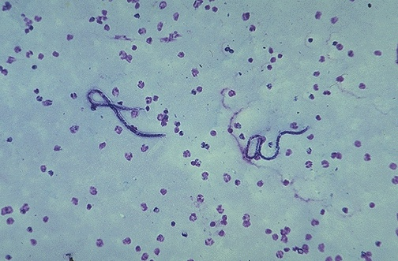
Elephantiasis: is a rare disorder of the lymphatic system caused by parasitic worms such as Wuchereria bancrofti, Brugia malayi, and B. timori, all of which are transmitted by mosquitos. Inflammation of the lymphatic vessels causes extreme enlargement of the affected area, most commonly a limb or parts of the head and torso. It occurs most commonly in tropical regions and particularly in parts of Africa.

Slide 15
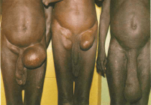
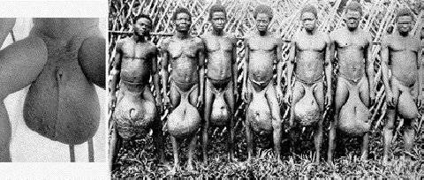

Slide 16
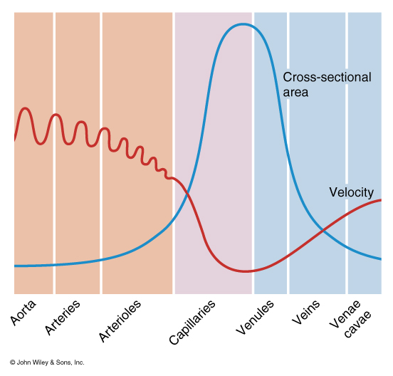
Factors That Affect Circulation
Velocity of Blood:
1. Measured as the volume of blood that flows through any tissue in a given time period.
2. Velocity is inversely related to cross-sectional area
Aorta: 3-5 cm2, 40cm/sec
Capillaries: 4,500-6,000 cm2/ 0.1cm/sec
Vena Cava’s: 14cm2, 5-20cm/sec

Slide 17
Factors That Affect Circulation
Resistance:
Measured as the opposition to blood flow through blood vessels due to friction between the blood and vessel walls.
1. Average Vessel radius:
Resistance is inversely proportional to the fourth power of the radius
2. Blood viscosity: Resistance is directly proportional to viscosity
3. Total Vessel length: Resistance is directly proportional to vessel length

Slide 18
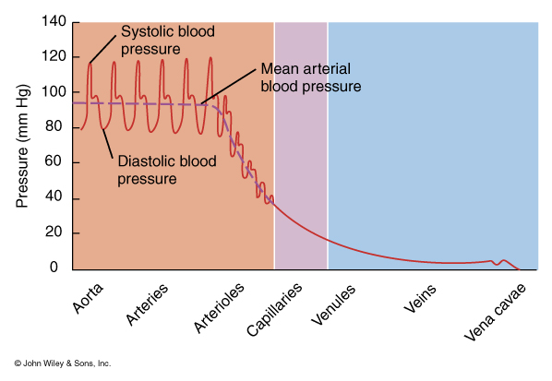
Factors That Affect Circulation
Volume of Blood Flow:
Measured by Cardiac Output
CO = SV x HR
Blood Pressure:
Measured as the Hydrostatic pressure exerted on vessel walls by the blood
Young Adult: 120/80
120 = ventricular systole
80 = ventricular diastole
Mean arterial blood pressure:
MABP = diastolic BP + 1/3(systolic BP – diastolic BP)

Slide 19
Factors That Affect Circulation
Cardiac Output is directly related to blood pressure
CO = MABP/R

Slide 20
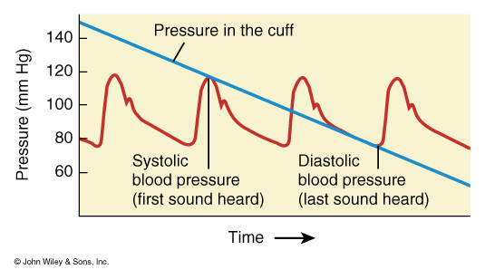
Relationship between Blood Pressure, Cuff Pressure, and Korotkoff Sounds
Blood Pressure is measured in the Brachial Artery using a Sphygmomanometer
As cuff pressure drops to a point where it equals systolic pressure the first Korotkoff sound is heard
As cuff pressure continues to drop to the point where it equals Diastolic pressure the last korotkoff sound is heard
Blood pressure is recorded as the first sound (systolic) and the last sound (diastolic) pressure

Slide 21
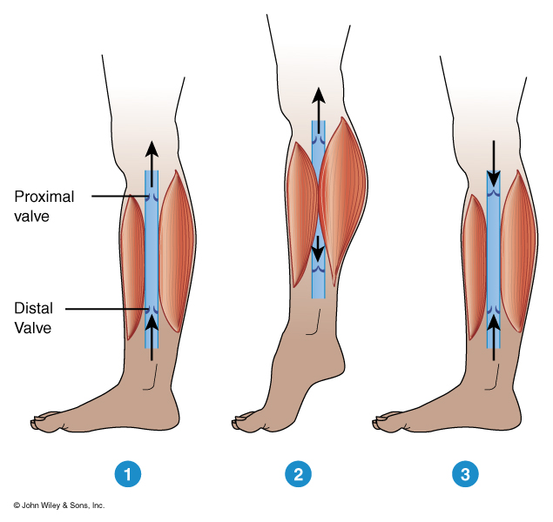
Action of Skeletal Muscle in Venous Return
While standing at rest venous valves are open
Contraction of muscles pushes blood upward through the proximal valve, back-pressure closed the distal valve
As muscle relaxes, pressure drops closing the proximal valve. Higher blood pressure in the foot opens the distal valve allowing blood to flow into section of the vein.

Slide 22
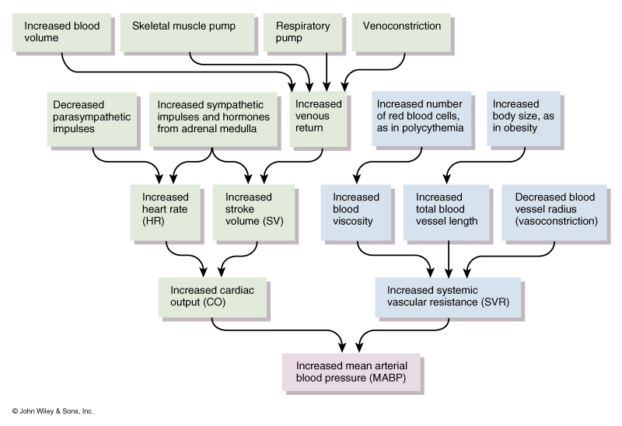
Summary of Factors that Increase Blood Pressure

Slide 23
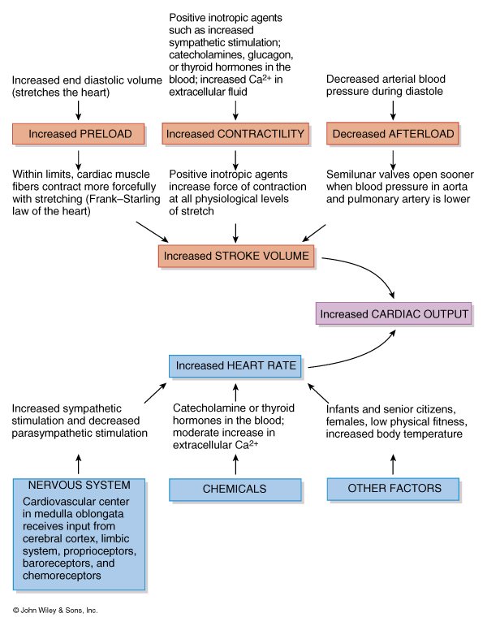
Overview of Hormones that Regulate Blood Pressure
Cardiac Output:
Increased CO = Increased BP
Increased CO and contractility
epinephrine from Adrenal Medulla
Norepinephrine from sympathetic neurons

Slide 24
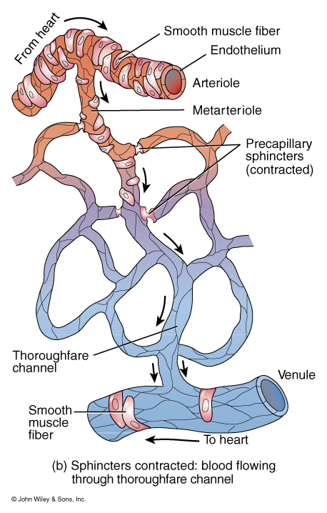
Overview of Hormones that Regulate Blood Pressure
Systematic Vascular Resistance
1. Vasoconstriction (increased)
a. Angiotensin II
b. ADH (vasopressin)
c. Epinephrine
d. Norepinephrine
2. Vasodilation (decreased)
a. ANP
b. Epinephrine
c. Nitric Oxide

Slide 25
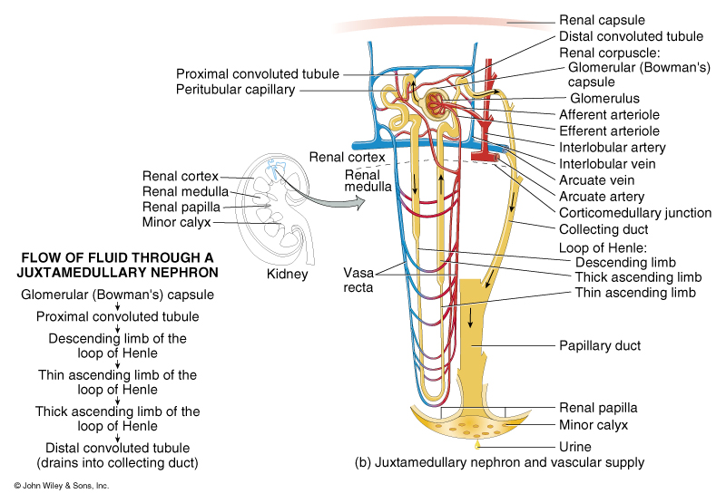
Overview of Hormones that Regulate Blood Pressure
Blood Volume
1. Increased
a. Aldosterone
b. ADH
2. Decreased
a. ANP

Slide 26
Hypovolemic Shock
During to decreased blood volume
Stages of shock
Stage 1: compensated or nonprogressive
Stage 2: decompensated or progressive (up to 25% loss)
Stage 3: irreversible shock (death)

Slide 27
Hypovolemic Shock
Stage 1: compensated or nonprogressive
a. Activation of the sympathetic nervous system
b. Activation of the renin-angiotensin pathway
c. Release of ADH
d. Signs of clinical hypoxia
Stage 2: decompensated or progressive (up to 25% loss)
a. Depressed cardiac activity (MABP as low as 60)
b. Depressed vasocontriction (MABP as low as 40)
c. Increased capillary permeability
d. Intravascular clotting
e. Cellular death occurs
e. Respiratory acidosis

Slide 28
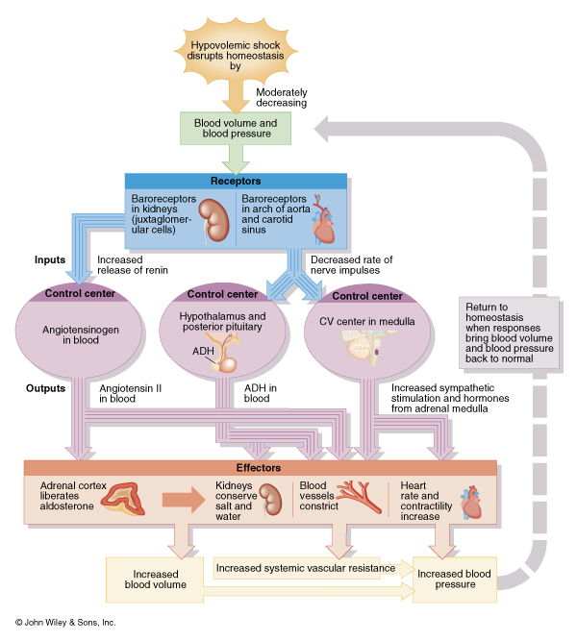
Negative Feedback response to Hypovolemic Shock

Slide 29
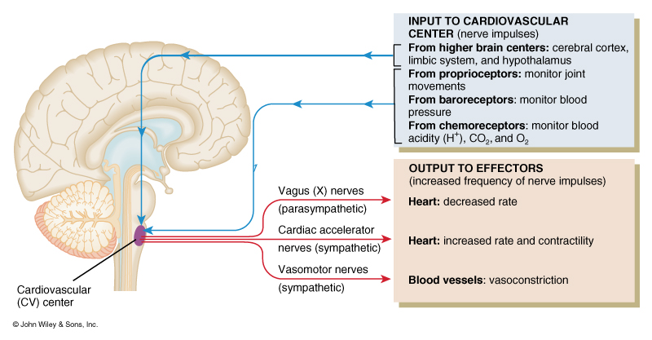
CNS Input and Regulation of Cardiac Activity

Slide 30
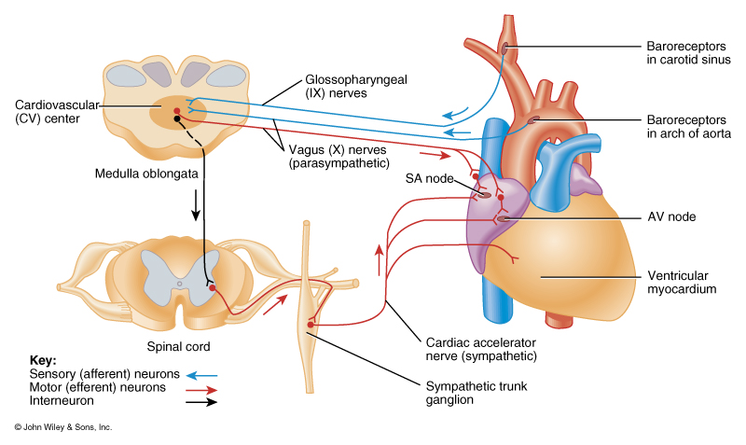
ANS Regulation of Cardiac Activity

Slide 31
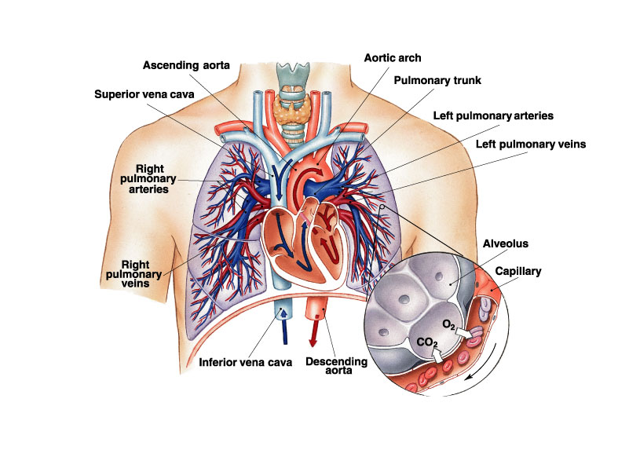
Arteries and Veins of the Heart

Slide 32
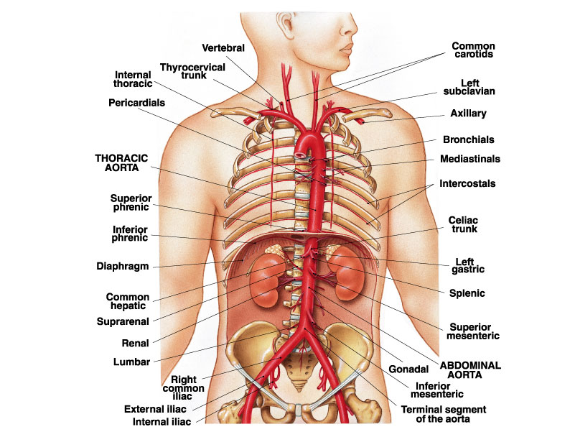
Major Arteries of the Thoracic Region

Slide 33
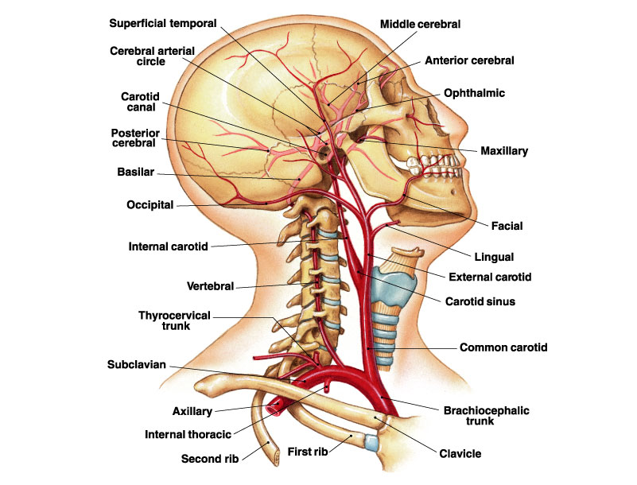
Major Arteries of the right side

Slide 34
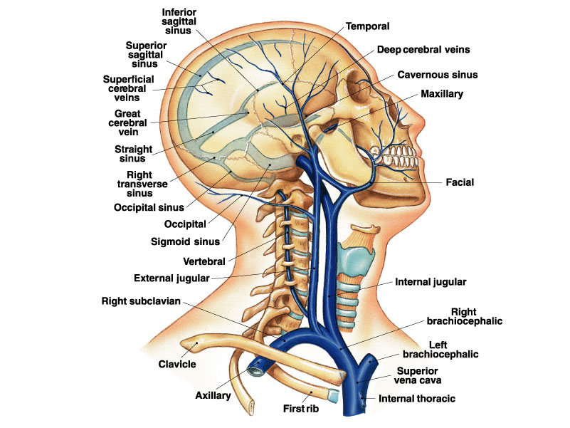
Veins of the Upper Thoracic Region

